Slide 1
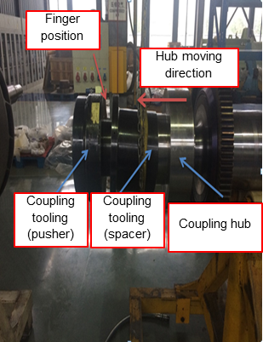
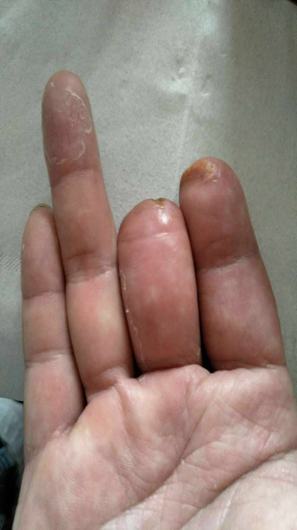
HS&E INCIDENT BULLETIN |  | 2nd half year 2016
Shanghai, China | Type of incident (Partial Amputation – Line of Fire)
Summary:
Shop employees were removing a hydraulic coupling hub from a steam turbine rotor for final shipment preparation. Upon the first attempt, they were unsuccessful in getting the coupling to expand. They removed all tooling and reviewed to ensure that everything was functioning properly. During the second attempt, they brought the pumps to 1000 bar (14,504 psi) utilizing the time intervals to raise the pressures. As a result, they say the 500 psi (0.24 bar) pressure on the pusher rose and then slowly decreased pressure on the pusher tool to zero. They then decreased pressure on the expansion tool to zero. Following this, they removed the hydraulic hose utilizing the quick disconnects and proceeded to remove the tooling. Because of the weight of the pusher tool, multiple people were utilized to handle the tooling. As the pusher tool was near disengagement, one of the employees’ hands was in the pinch point between the pusher tool and the spacer when the coupling unexpectedly sprang off the taper. This resulted in significant trauma to the employee’s hand, including partial amputation of fingers.
Root Causes: | Actions Taken Thus Far: Next Steps
When the hoses were removed, the quick disconnects were left in place; as the coupling returned to its original size, pressure increased until it caused an explosive release. The coupling had not fully disengaged as thought by the team. Procedure covers the need to support the weight of the pusher tool. However, this was not followed by the team. Based upon the design of the tooling, they decided to handle the support manually. Without a HIRA or JSEA to focus, the team was not able to identify the risks and ways to mitigate them and placed themselves at very high risk. | Ensure to conduct toolbox meeting at the start and end of each shift. End of shift toolbox meeting is to review the day’s issues, provide recognition etc. Supervisor to lead this meeting and attended by safety manager. Shop supervisor to lead HIRA/JSEA review before start of each shift. Assess key technical competency for shop employees. Review with management and prepare plan to close gap.

